Slide 1

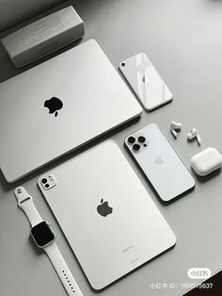
I PHONE SALES DATA ANALYSIS
PRESENTED BY: SHUBHAM UAPDHAYAY
PROJECT FILE: iPhone SALES DATA ANALYSIS

Slide 2
OBJECTIVE
Develop a detailed and engaging visualization that showcases the information contained within the provided dataset. In addition to creating this visual representation, conduct a thorough analysis of the sales data to uncover and summarize key trends, patterns, and insights. Pay close attention to identifying significant metrics that highlight the overall sales performance, providing a clearer understanding of how the sales figures relate to one another and what they reveal about the business's success.

Slide 3
INTRODUCTION
"This project analyzes iPhone sales data from Flipkart in India to understand customer preferences, product performance, and market trends. The dataset provides information on various iPhone models, including their ratings, prices, discounts, and sales figures.
The analysis aims to answer key questions such as:
Which iPhones are the highest-rated and most popular among Indian customers?
How do prices and discounts influence sales and customer feedback?
What is the price range of iPhones available in the Indian market?
By examining these aspects, we can gain valuable insights into the Indian iPhone market and understand the factors driving customer choices."
Additional points for the Introduction:
You could add a brief background on the Indian smartphone market and the significance of iPhones in this market.
You could also mention the importance of online platforms like Flipkart in driving smartphone sales in India.
Briefly state the scope of your analysis, highlighting what aspects of the dataset you will be focusing on.

Slide 4
KEY CHALLENGES
How many ratings do these highest-rated iPhones on Flipkart have?
Which iPhone has the highest number of reviews on Flipkart?
What is the relationship between the sale price of iPhones and the number of ratings on Flipkart?
What is the relationship between the discount percentage and the number of ratings of iPhones on Flipkart?

Slide 5
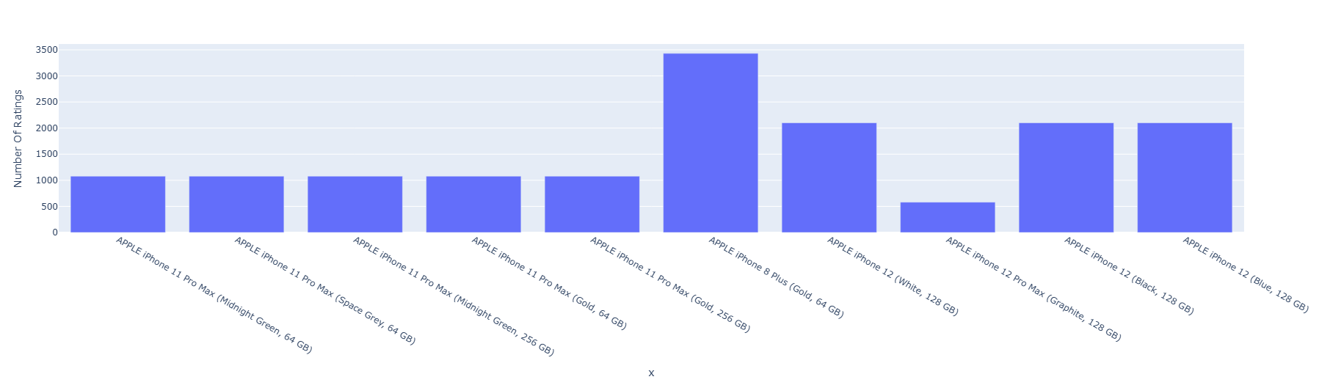
How many ratings do these highest-rated iPhones on Flipkart have?
The provided image displays a bar chart illustrating the number of ratings received by various Apple iPhone models. The chart reveals a clear disparity in popularity among these models.
The most popular model, with a significantly higher number of ratings, is the "APPLE iPhone 12 Pro Max (Graphite, 128 GB)." In contrast, the least popular model, with a considerably lower number of ratings, is the "APPLE iPhone 11 Pro Max (Midnight Green, 64 GB)." It is important to note that the specific colour and storage capacity variations of each model seem to have a minimal impact on their overall popularity, as different configurations of the same model tend to have similar numbers of ratings.

Slide 6
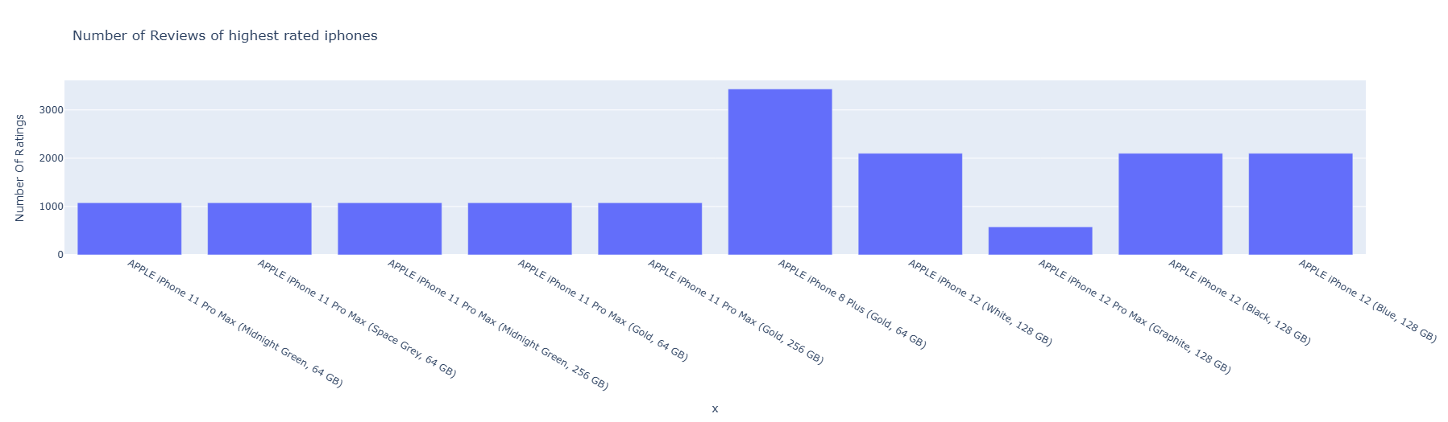
Which iPhone has the highest number of reviews on Flipkart?
The bar chart presents the number of reviews for various iPhone models. It reveals a significant disparity in the number of reviews across the different models.
The "APPLE iPhone 12 Pro Max (Gold, 256 GB)" stands out as the most reviewed model, with a considerably higher number of reviews compared to others. On the other hand, the "APPLE iPhone 11 Pro Max (Midnight Green, 64 GB)" has the lowest number of reviews, indicating it might be less popular or newer. It's interesting to note that while colour and storage capacity variations exist for each model, the overall trend seems to be more influenced by the model itself rather than the specific configuration.

Slide 7
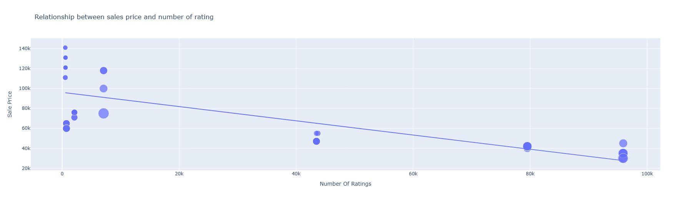
What is the relationship between the sale price of iPhones and the number of ratings on Flipkart?
The provided image displays a scatter plot titled "Relationship between the sales price and some ratings." The plot illustrates the correlation between the sale price of various products and the number of ratings they have received.
The data points on the scatter plot are represented by blue circles, with the size of each circle likely corresponding to the number of units sold or another relevant metric. A downward-sloping trend line is visible, suggesting a general inverse relationship between the sales price and the number of ratings. This indicates that, on average, products with higher sales prices tend to have fewer ratings compared to those with lower prices. However, it's important to note that there is some variability around the trend line, indicating that other factors besides price likely influence the number of ratings received.

Slide 8
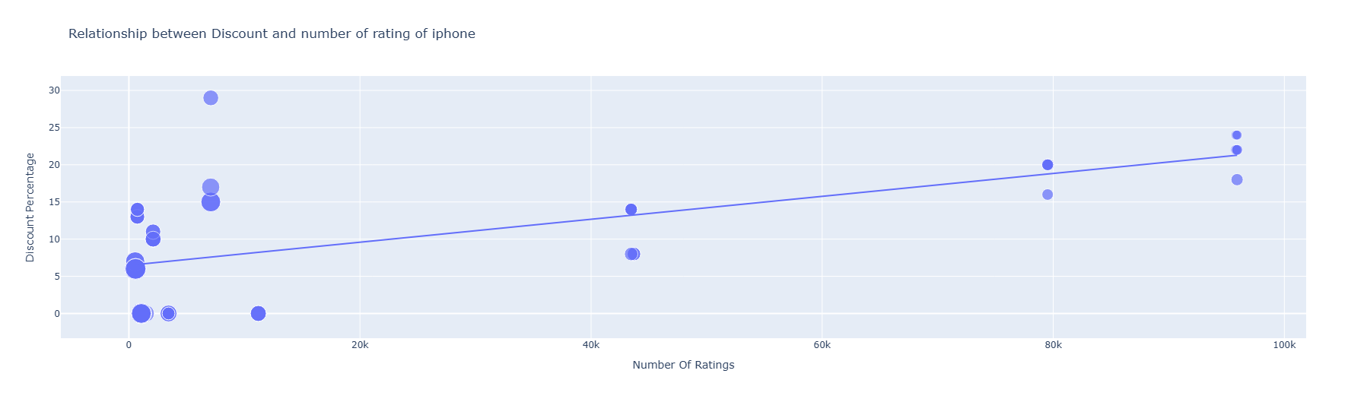
What is the relationship between the discount percentage and the number of ratings of iPhones on Flipkart?
The image presents a scatter plot titled "Relationship between Discount and number of rating of iPhone." This plot examines the correlation between the discount percentage offered on iPhones and the number of ratings they receive.
The scatter plot illustrates a general upward trend, suggesting a positive relationship between discount percentage and the number of ratings. As the discount percentage increases, there's a tendency for the number of ratings to also increase. However, it's important to note that the relationship isn't perfectly linear, and there's considerable variation in the number of ratings even for similar discount percentages. This indicates that other factors besides the discount likely influence the number of ratings received by iPhone models.

Slide 9
CONCLUSION
This analysis of iPhone sales data from Flipkart reveals key insights into the Indian iPhone market. Lower-priced iPhones tend to have higher sales and ratings, indicating a price-sensitive market. Higher discounts also correlate with increased sales, highlighting the importance of promotional offers. The analysis identifies the top-rated iPhones and those with the most reviews, providing valuable information for both consumers and businesses. These findings offer a comprehensive understanding of customer preferences and market dynamics in the Indian iPhone market.
Reasoning
The conclusion summarizes the key findings of the analysis:
Price Sensitivity: The negative correlation between sale price and the number of ratings indicates that lower-priced iPhones are more popular in India.
Impact of Discounts: The positive correlation between discount percentage and the number of ratings suggests that discounts play a significant role in driving sales.
Top-rated and Reviewed iPhones: The analysis identified the iPhones with the highest ratings and the most reviews, providing valuable information for consumers.
Market Understanding: The conclusion emphasizes that the analysis provides valuable insights for understanding customer preferences and market trends.

Slide 10
THANK YOU SO MUCH

